Slide 1
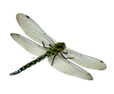
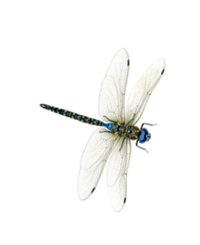
Интерактивный тренажёр
Математика 2 класс
учитель начальных классов
Аббазова И.Ф.

Slide 2
12 14
<
=
>

Slide 3
18 16
<
=
>

Slide 4
14 12
<
=
>

Slide 5
19 19
<
=
>

Slide 6
16 18
<
=
>

Slide 7
13 12
<
=
>

Slide 8
11 9
<
=
>

Slide 9
13 15
<
=
>

Slide 10
16 10
<
=
>

Slide 11
16 16
<
=
>

Slide 12
20 18
<
=
>

Slide 13
19 8
<
=
>

Slide 14
12 16
<
=
>

Slide 15
12 11
<
=
>

Slide 16
10 14
<
=
>

Slide 17
16 17
<
=
>

Slide 18
14 19
<
=
>

Slide 19
14 14
<
=
>

Slide 20
17 13
<
=
>

Slide 21
19 14
<
=
>

Slide 22
10 15 - 5
<
=
>

Slide 23
16 + 1 18
<
=
>

Slide 24
17 - 10 7
<
=
>

Slide 25
19 - 10 11
<
=
>

Slide 26
19 - 9 15
<
=
>

Slide 27
16 - 10 5
<
=
>

Slide 28
18 10 + 8
<
=
>

Slide 29
10 + 4 12
<
=
>

Slide 30
10 + 3 13
<
=
>

Slide 31
Источники
https://i.ytimg.com/vi/rAhnokirOGs/maxresdefault.jpg -фон
https://documents.infourok.ru/69cf0706-b6f0-4482-9837-52d3882ab4a1/0/image009.jpg -фон
https://i.ya-webdesign.com/images/dragonfly-clipart-transparent-background.png -стрекоза
https://thumbs.dreamstime.com/b/%D0%BB%D0%B8%D1%81%D1%82-%D1%8F%D0%B1-%D0%BE%D0%BD%D0%B8-%D0%B8%D0%B7%D0%BE-%D0%B8%D1%80%D0%BE%D0%B2%D0%B0%D0%BD%D0%BD%D1%8B%D0%B5-%D0%BD%D0%B0-%D0%B1%D0%B5-%D0%B8%D0%B7%D0%BD%D0%B5-90736277.jpg - лист
https://img1.liveinternet.ru/images/attach/d/2/149/621/149621079_4897960_0_10ef29_2d846e1_orig.png -кнопка перехода

